Slide 1
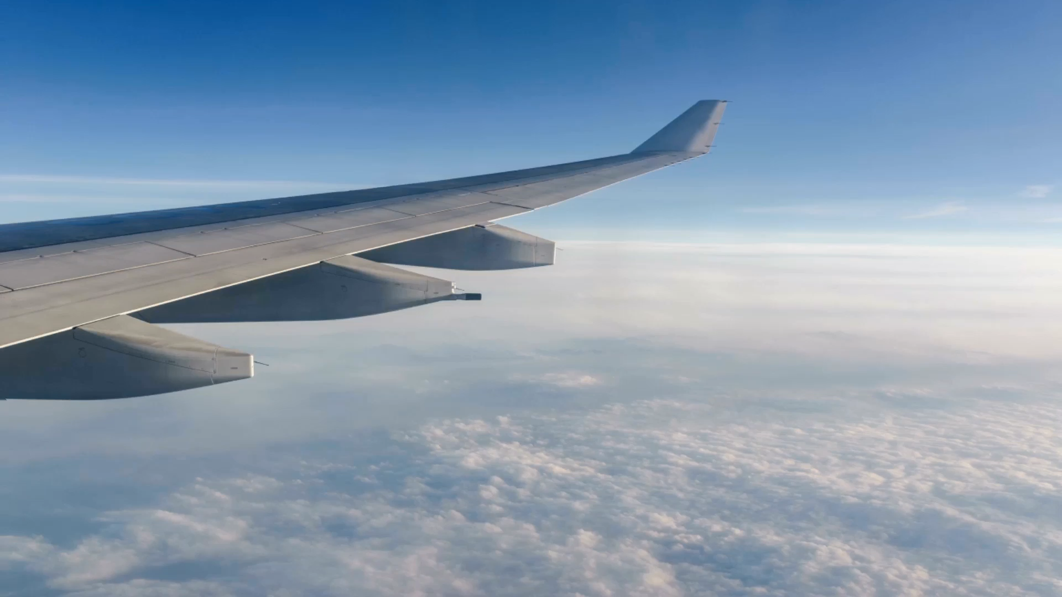
BRITISH AIRWAYS
CUSTOMER RATING ANALYSIS AND INSIGHTS

Slide 2
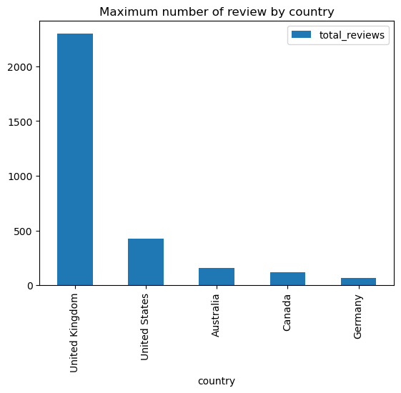
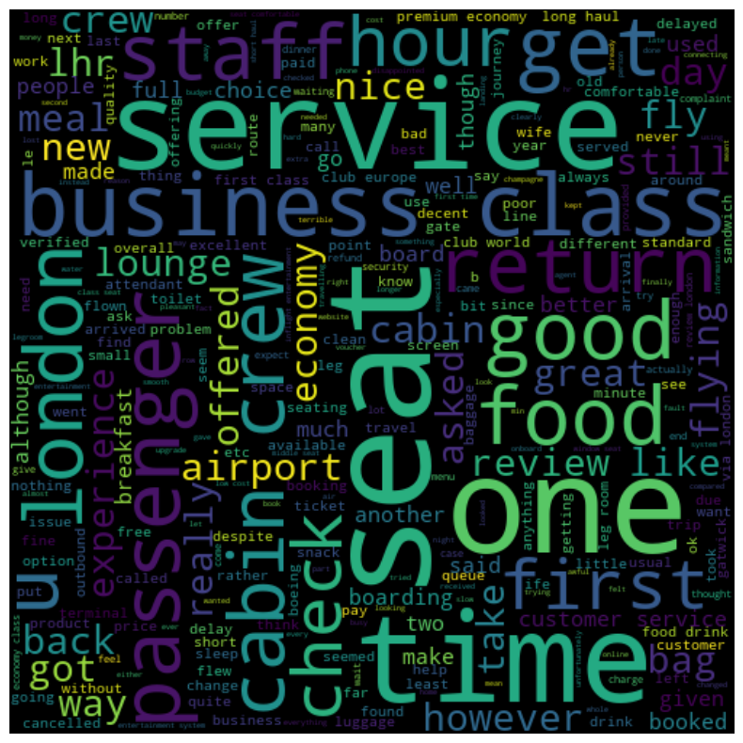
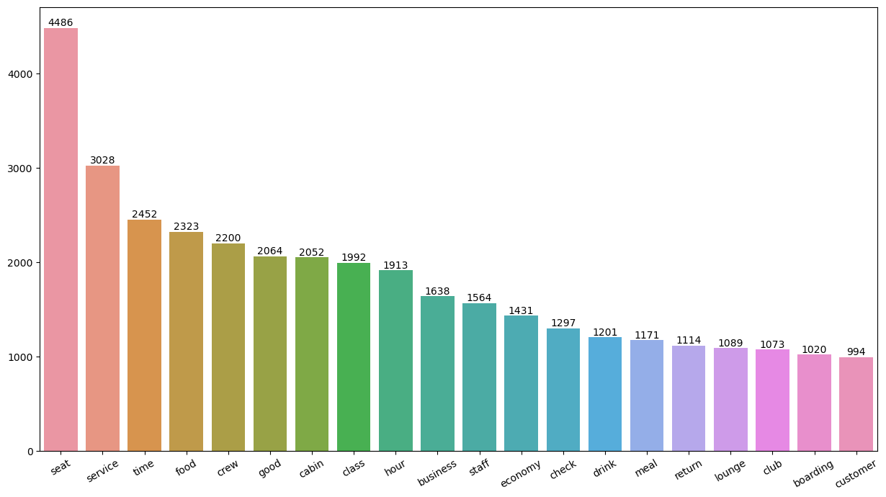
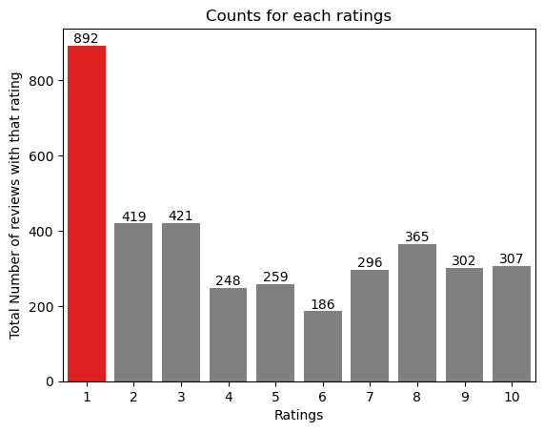
KEY METRICS
AVERAGE RATING
4.64
REVIWED COUNTRIES
102
TOTAL REVIEWS
3825
What customers are happy and unsatisfied about for different ratings class:
7-10 ratings wrote about comfortable seats, good inflight entertainment, descent food quality.
4-6 ratings faced problem with small entertainment screen, long passport check queue, bad business class experience.
1-3 ratings wrote dissatisfaction on congested middle seat and small screen while they liked the seats and the food.
All Customers liked Cabin crew service and staff, general economy seats. Many travelled in Business class.
Focus on – Economy class service, seats, enhance inflight entertainment experience and importantly Delays. Enhance the experience of business class, it seems customers want value for money. Improve Customer service on refund requests and process.

